Slide 1
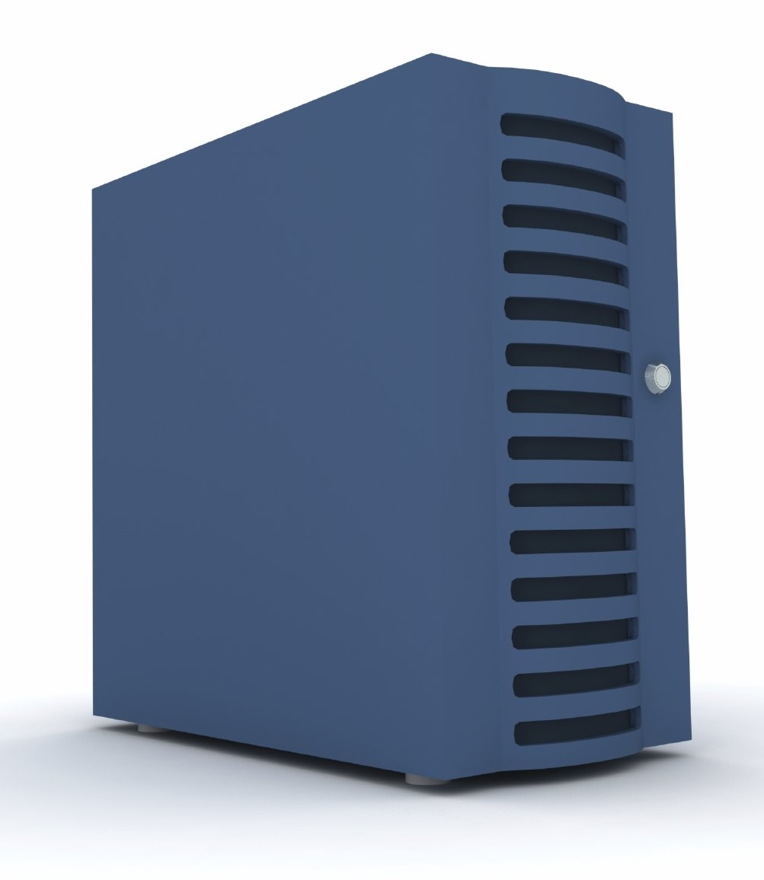


Basics of ATM Load File
  States
  Screens
  FIT’s
  Configuration Params
$data1.loadfile.ncrcnfg
Concerto Software and Systems Pvt. Ltd.

Slide 2
Contents
Introduction
Configuration Data
  State Tables
  Screen Tables
  Financial Institution Tables (FITs)
  Configuration Parameters File
  Configuration/Load file Editors
  Sample Transaction Flow
Concerto Software and Systems Pvt. Ltd.

Slide 3
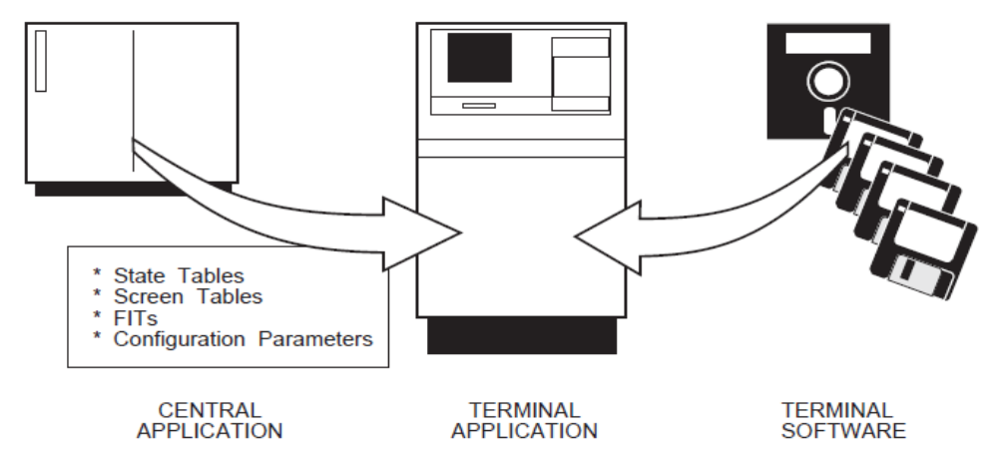
Introduction
Concerto Software and Systems Pvt. Ltd.

Slide 4
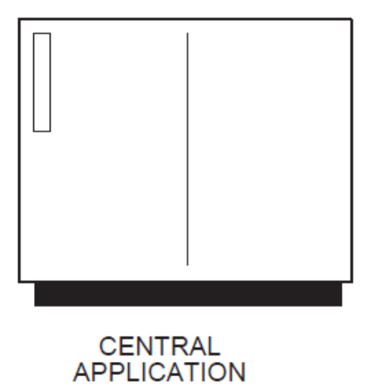
Introduction
Central Application
When we speak of the Central application, we mean the systems,
such as Base24 that controls the network of ATM terminals.
The Central application performs the following jobs:
  Downloads the configuration data to the terminal.
  Receives transaction requests from the terminal, and determines if the transaction is to be approved or declined and how the transaction should finish.
  Sends commands to control the terminal, such as Start-Up, Shut-Down, etc.
  Responds to messages sent by the terminal.
The Central application must be able to decode messages coming from the terminal and code messages in a form that the software in the terminal understands. It must also be able to act on any messages it receives from the terminal, such as transaction request messages and status messages.
Concerto Software and Systems Pvt. Ltd.

Slide 5
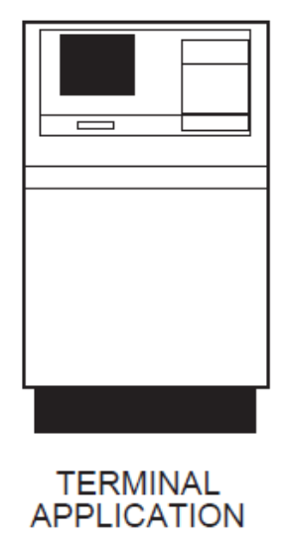
Introduction
Terminal Application
As its name suggests, the terminal application resides in the
terminal. It performs the following three main jobs:
Transaction Processing - It offers and leads the cardholder
through transactions
Supervisor Functions - It provides the operator with menus to
carry out terminal management functions, like replenishing supplies (cash, printer paper, printer ribbon), displaying counters and setting local configuration parameters
Terminal Status - It monitors the status of the terminal and reports exceptions both locally and to Central.
The terminal application is made up of 2 parts, terminal software and configuration data. Terminal software is Installed by ATM Vendor and Configuration data is what we create to customize the terminal software, and in particular, the transaction processing function.
Concerto Software and Systems Pvt. Ltd.

Slide 6
Configuration Data
Some of the main types of configuration data are as follows:
State Tables - These define how the terminal will process the transaction.
Screen Tables - These contain the screens that the terminal displays to the cardholder and the supervisor
Financial Institution Tables (FITs) - FITs are tables that define what cards are accepted by this terminal application. It also contains some local PIN verification specific parameters.
Configuration Parameters File - This contains various parameters that customize the terminal, such as timers and configuration options.
Concerto Software and Systems Pvt. Ltd.

Slide 7
Load file/Configuration File Editors
There are two types of configuration file editors commonly used:
DCT- The NCR Configuration File, which resides in the BASE24-atm system, can be accessed and downloaded to the ATM from the DCT
using screen 45. With access to the configuration file, you can make
changes to ATM screen displays, state table entries, FIT table data,
configuration parameters, and timers. You then download these changes to
the ATM using the DCT or using NCPCOM commands.
Entibold- The Diebold Configuration File, which resides in the BASE24-atm system, can be accessed using entibold program. With access to the configuration file, you can make changes to ATM screen displays, state table entries, FIT table data, configuration parameters, and timers. You then download these changes to the ATM using NCPCOM commands.
Concerto Software and Systems Pvt. Ltd.

Slide 8
Sample Transaction Flow
Following example shows a simple transaction flow and the different types of states required for the same:
The flow performs following basic operations,
  Prompts the cardholder to enter a card
  Reads the cardholder’s card and Prompts for the PIN
  Displays a transaction selection screen. This flow offers Cash, Statement and Balance transactions. If the cash option is selected, the flow offers a fixed amount selection screen, with an OTHER option to allow the cardholder to enter some other amount
  Sends a Transaction Request to Central and executes the function identified in the Transaction reply
  Closes the transaction and returns to the welcome screen.
Concerto Software and Systems Pvt. Ltd.

Slide 9
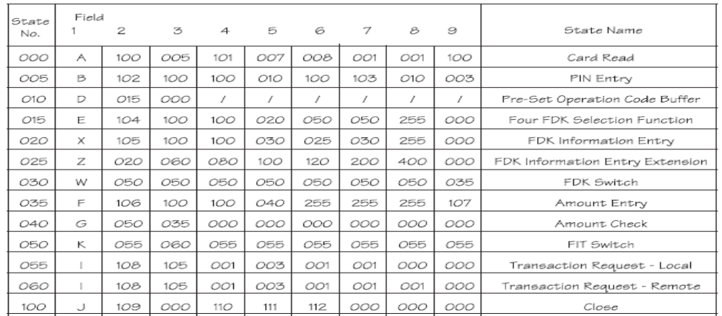
Sample Transaction Flow
Following table shows different types of states and their parameters required for this flow,
Concerto Software and Systems Pvt. Ltd.

Slide 11
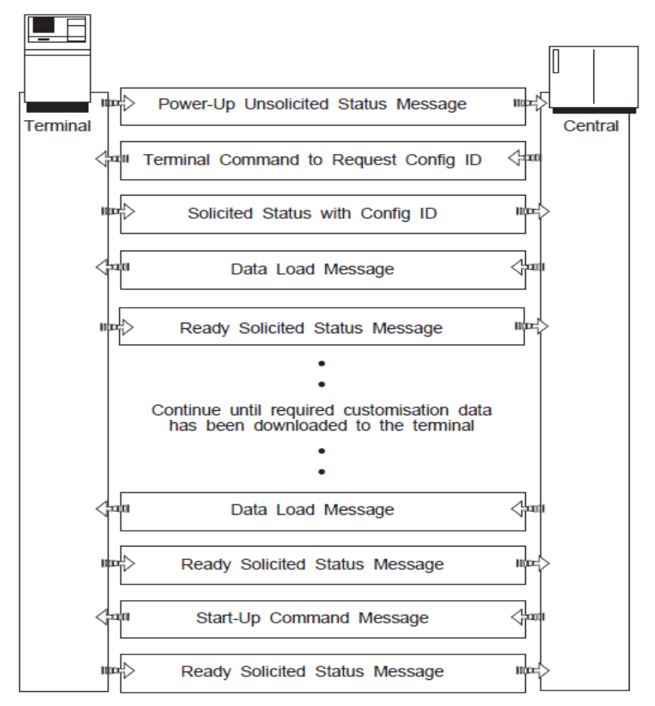
Start-Up Sequence
This illustration shows what happens when a terminal is connected to Central and is switched on.
Concerto Software and Systems Pvt. Ltd.

Slide 12
Thank You.
Concerto Software and Systems Pvt. Ltd.

